Slide 1
Class 08- List
Intro to list and its related operations

Slide 2
Introduction to Lists
Python lists are containers that are used to store list of heterogeneous values.
Python lists are mutable. That means we can change the elements inside the list.
Lists are similar to strings and tuples (they store sequence of characters), but strings and tuples are immutable.

Slide 3
Creating Lists
Empty lists :
l = list() or l =[]
Non-Empty lists:
l = [value1,value2,....] or l = [‘123’ , 456 , 7.89]
Nested lists:
l = [1 , 2 , [38 , 49] , 6]
Creating list from existing sequences:
l = list(<sequence>) #show this example..!!

Slide 4
Accessing Lists
Lists are collection of elements just like string(collection of characters).
Therefore we imply similar loop structures for lists.

Slide 5
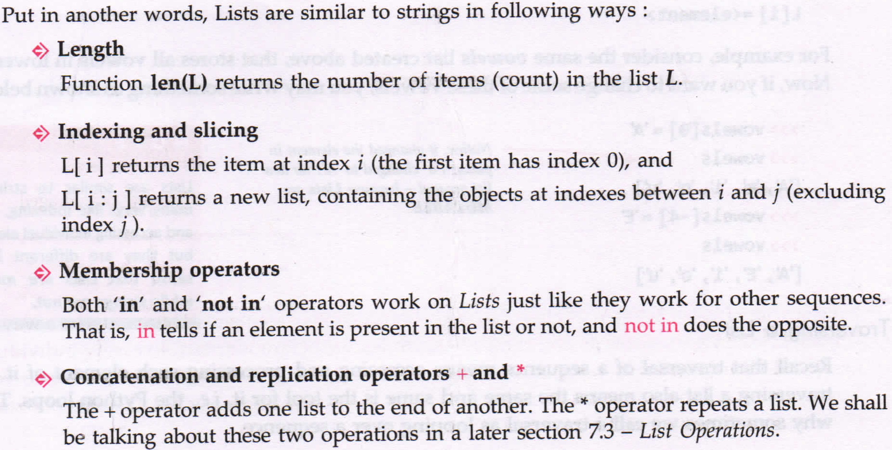
Similarity of lists with strings

Slide 6
Accessing Individual Elements
Try out with vowels = [‘a’ , ’e’ , ’i’ , ’o’ , ’u’]
vowels[0], vowels[4], vowels[-1], vowels[-3]
ACCESSING values beyond length of list elements vowels[5]
Compare mutability of strings and lists data structures...!!

Slide 7
Traversing a List
for loop makes it easy to traverse or loop over items in a list.
Traversing List is similar to traversing strings. It also same to methods of accessing elements using indexing and variable equivalent.
l = [10,12,34,1,43,6]
Method1 :
for i in range(len(l)):
print(l[i]) #Indexing Method
Method2:
for var in l:
print(var) #variable equivalent

Slide 8
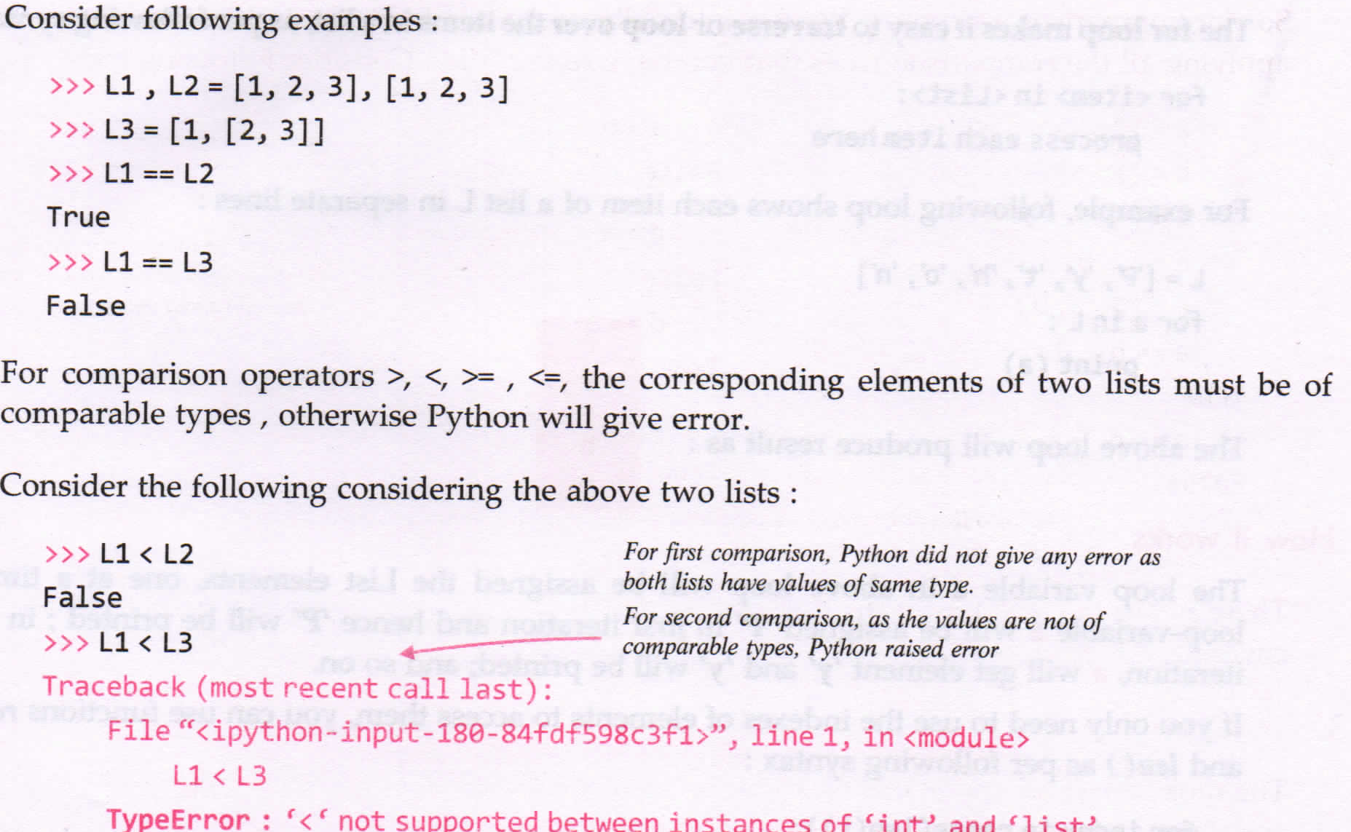
List Comparison

Slide 9
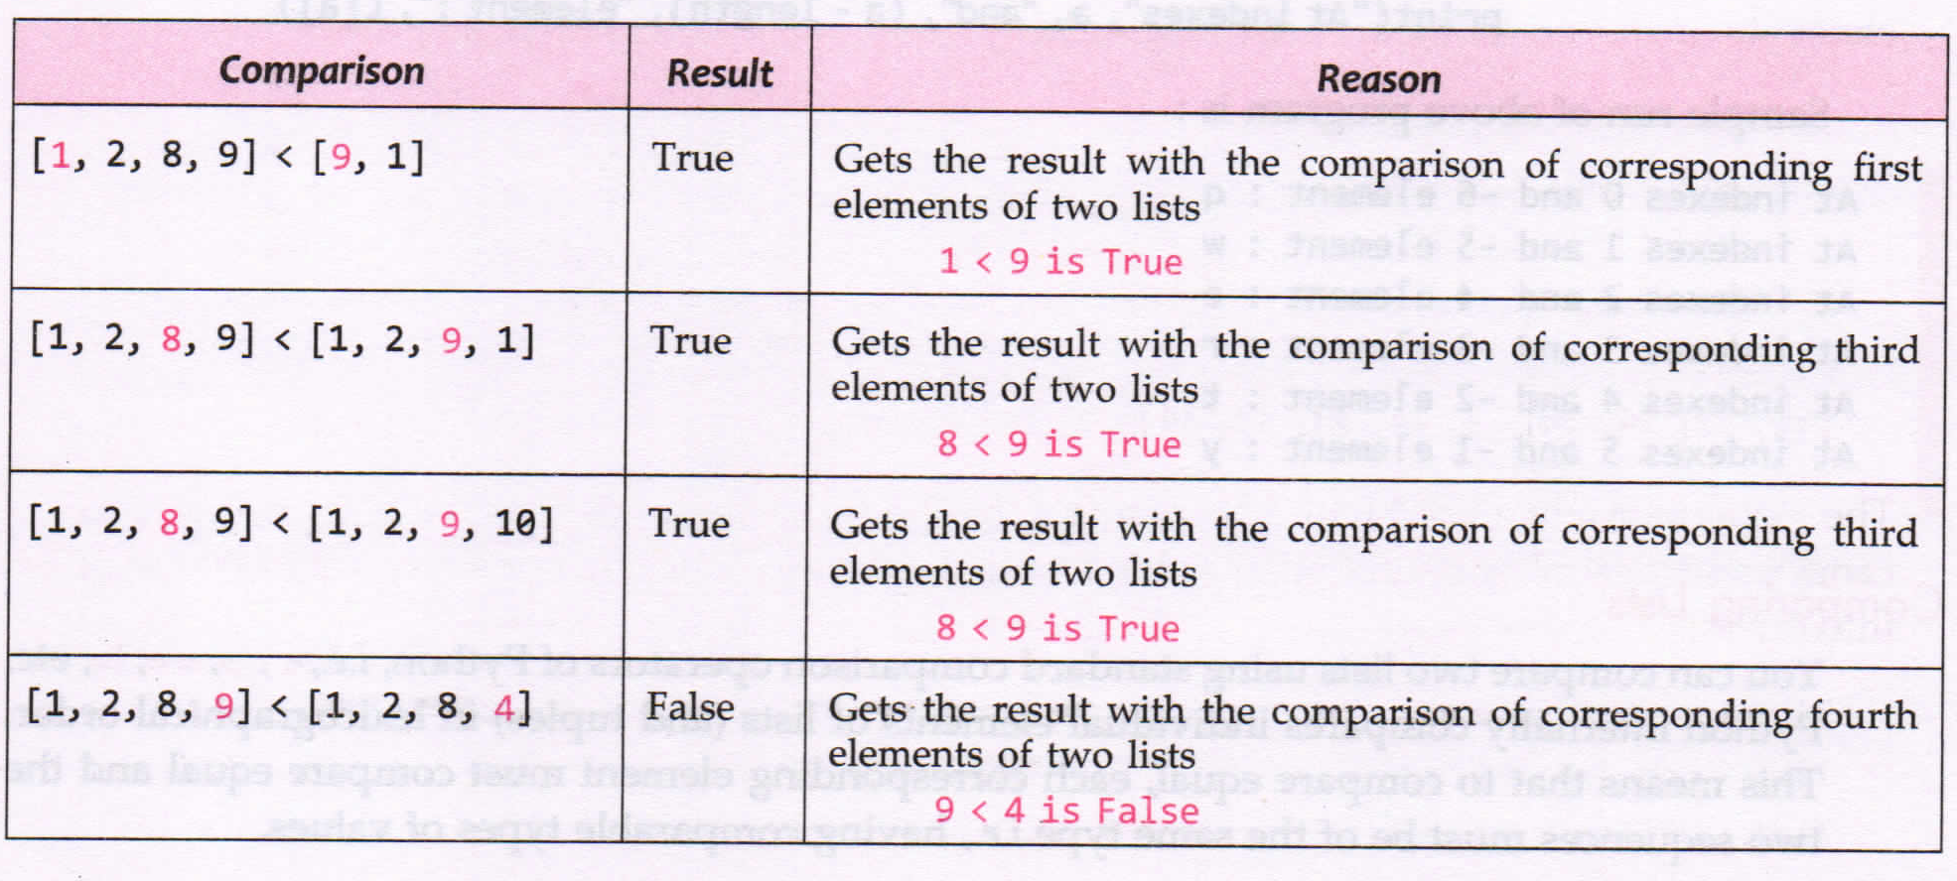

Slide 10
List Operations
Joining Lists
Repeating or Replicating Lists
Slicing Lists

Slide 11
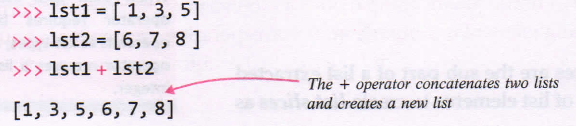
Joining lists(+ operator)
Similar to string concatenation, 2 list can also be concatenated into a new list having elements of the parent lists.
To perform this, we use + operator.

Slide 12
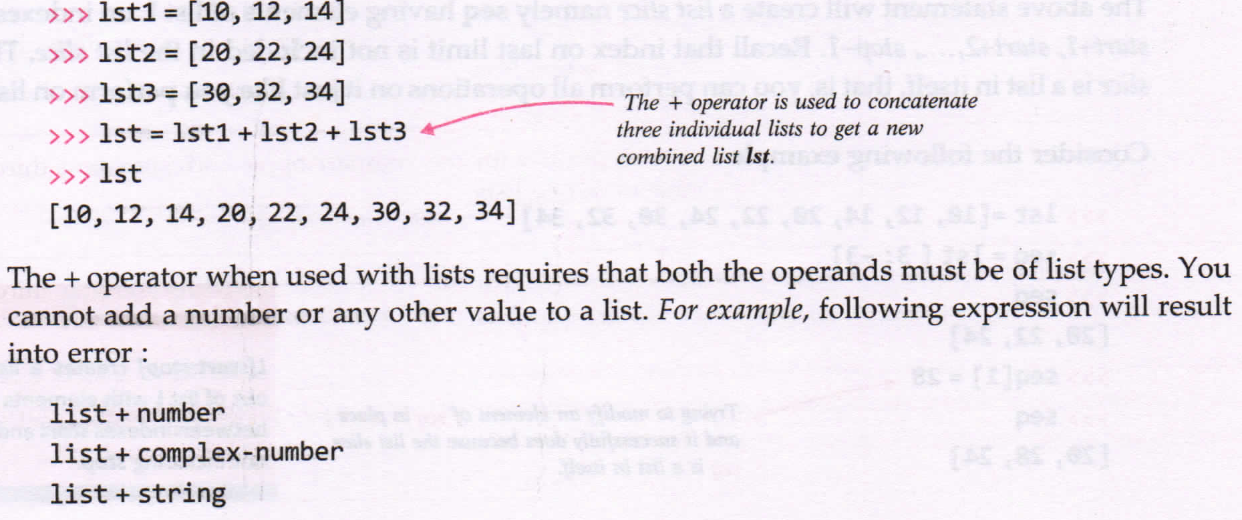

Slide 13
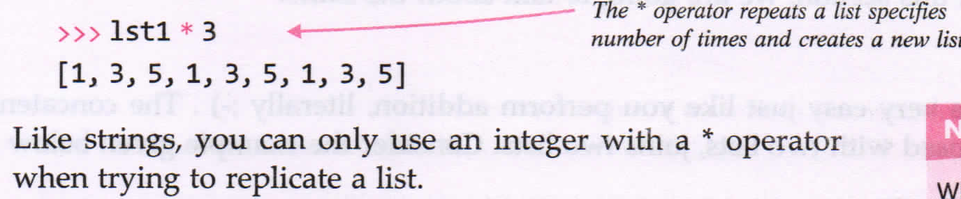
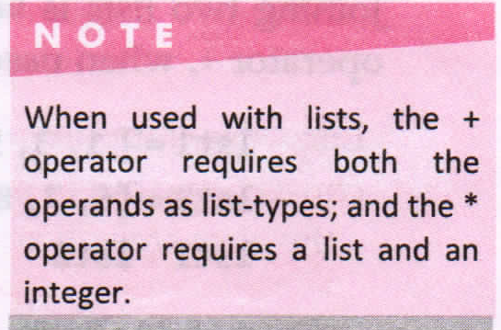
Repeating or replicating lists (* operator)
Like strings we can use * operator to replicate a list specified number of times

Slide 14
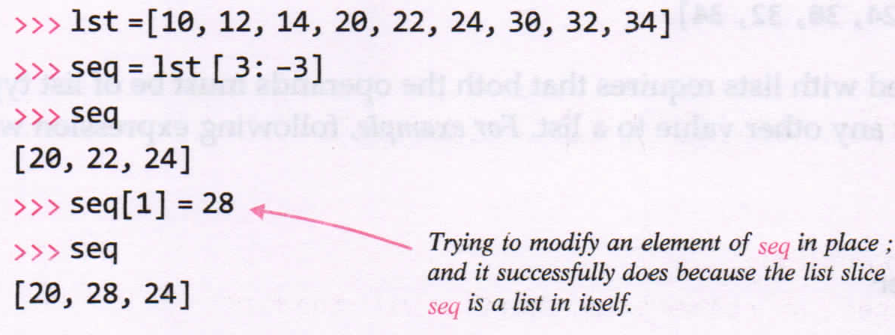
Slicing the lists
List slices, lie string slices are the sub part of a list extracted out.
FORMAT: seq = L[start:stop]
Variable seq wil have elements of lists L on indexes start, start+1, start+2, ..... , stop-2, stop-1. (Similar to string slicing)

Slide 15
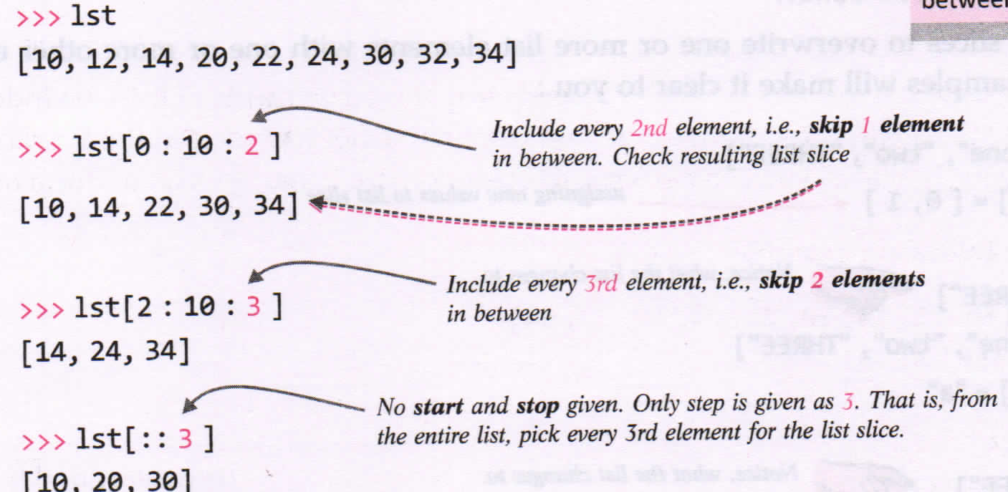
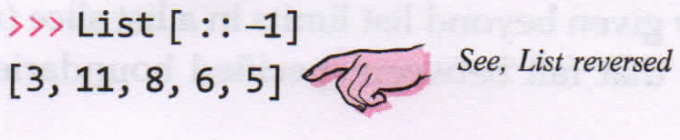
List also supports slice steps:
FORMAT: seq = L[start:stop:step]

Slide 16
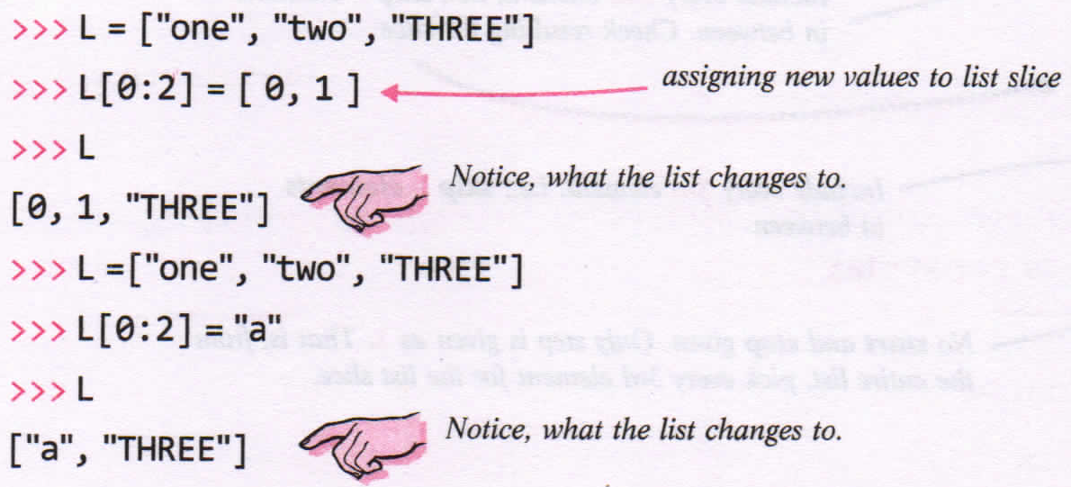
List Manipulation

Slide 17
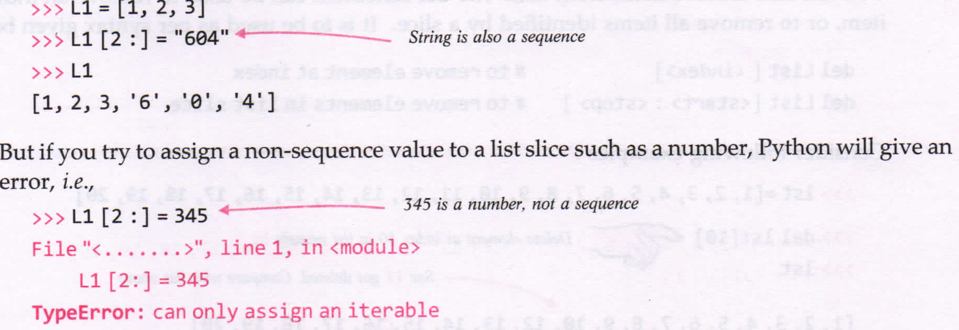

Slide 18
Functions in Lists
append() and pop()
index assignment
Deleting list (del)
index()
extend()
insert() and remove()
clear()
count()
reverse() and reversed()
sort() and sorted()
....... and many more..!!!!

Slide 19
append() AND pop()
append() method adds a single item to the end of the list.
FORMAT : L.append(<item>)
Example: l =[1,2,3,4,5,6]
.l.append(‘a’)
print(l) #Output: [1,2,3,4,5,6,’a’]
pop() method removes and return single element from the list.
Index is optional; if skipped, last element is deleted.
FORMAT : L.pop(<index>)
Example: l = [1,2,3,4,5,6,7]
l.pop(5) #removes and returns 5th index value
l.pop() #removes last element in the list

Slide 20
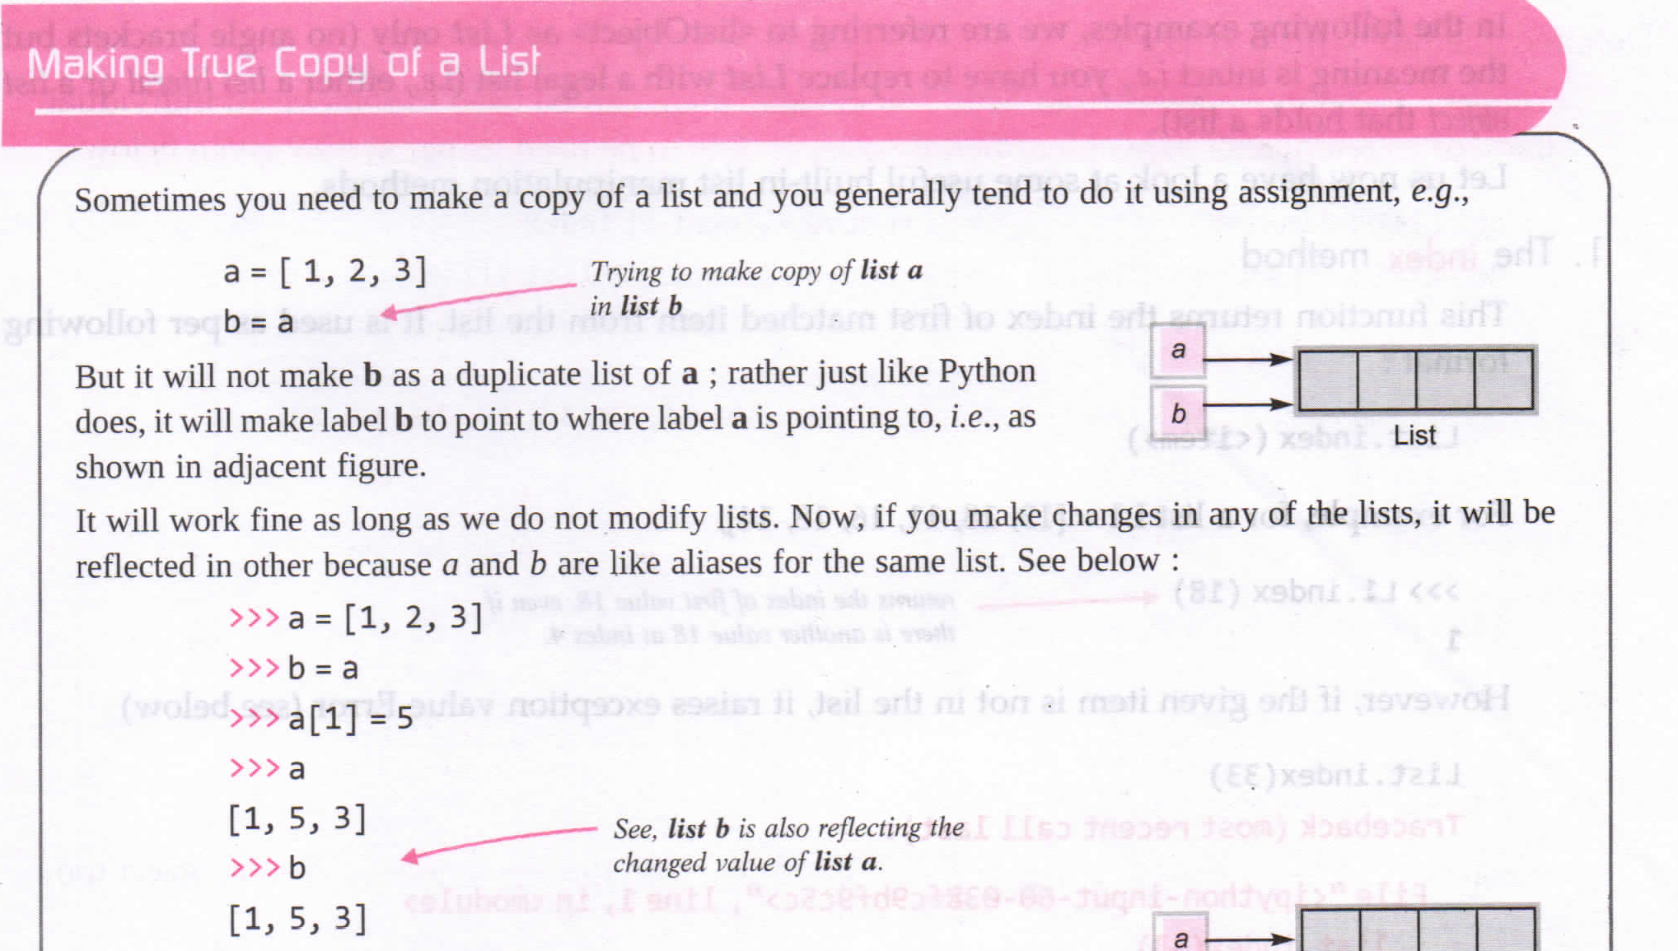

Slide 21
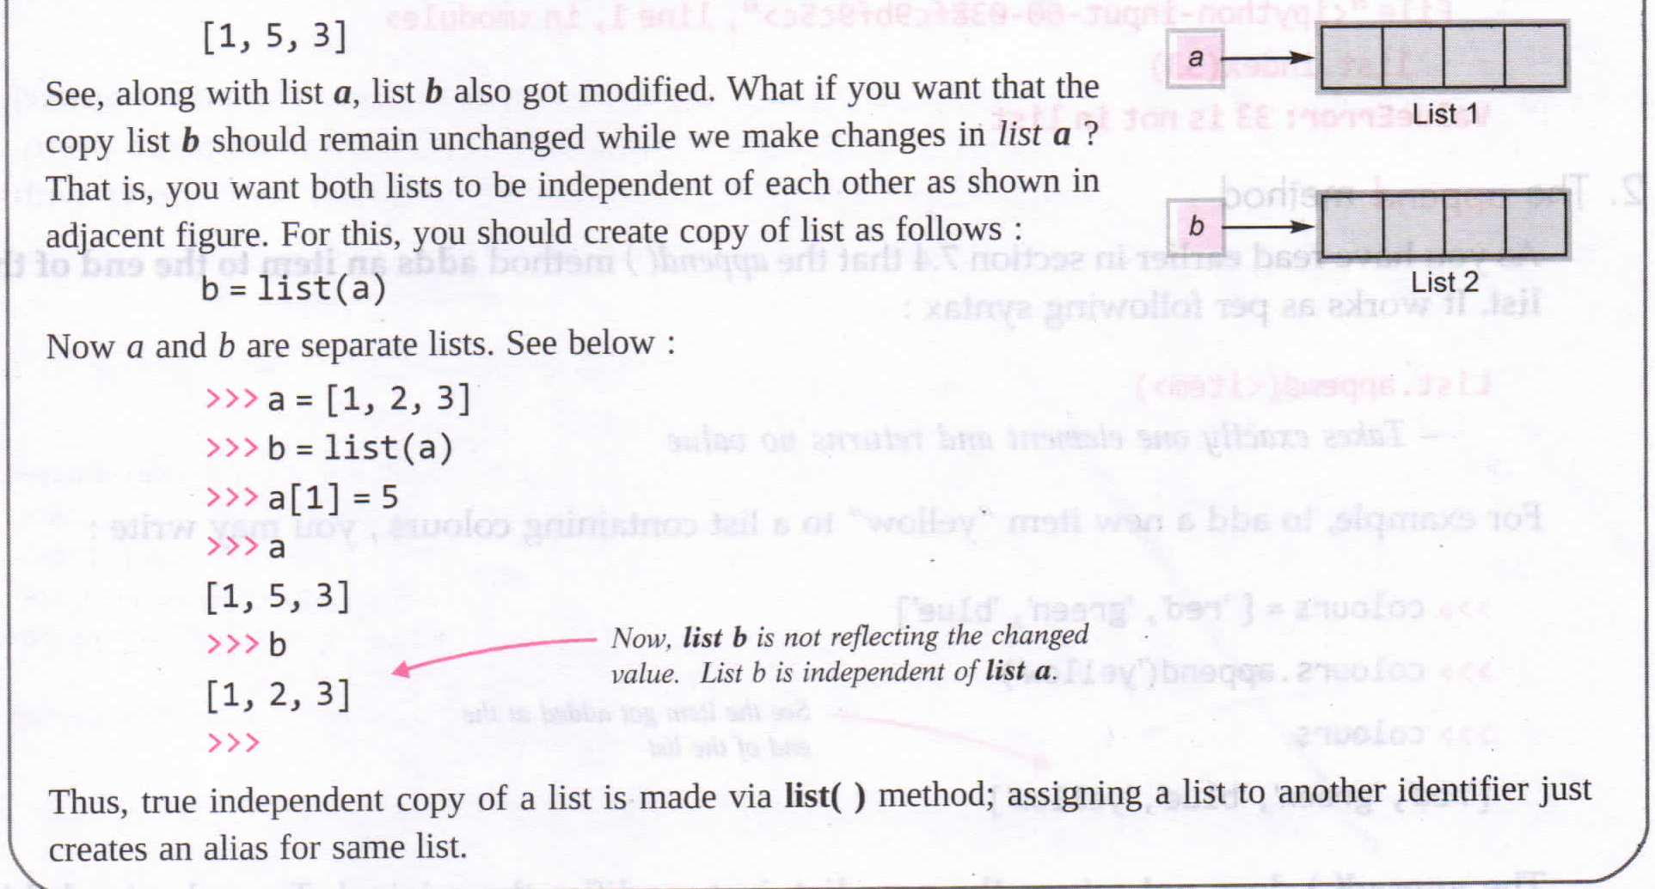

Slide 22
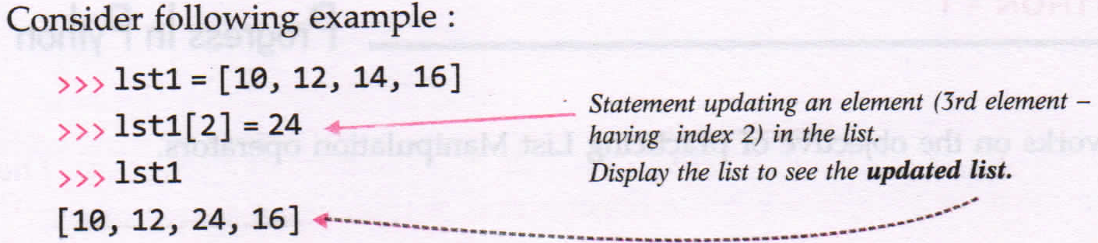
Index Assignment
To update or change an element of the list in place, we just have to assign new value to the element’s index as per format:
FORMAT : L[index] = <new value>

Slide 23
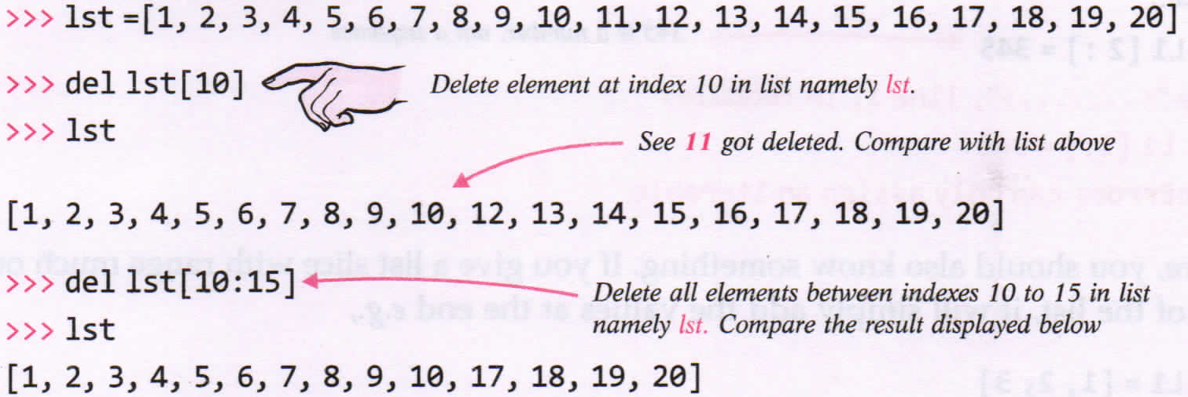
Deleting Elements from a list
The del statement can be used to remove an individual item or remove all items identified by a slice.
FORMAT: del List[<index>] #to remove element at index
del List[<start>:<stop>] #to remove elements in the list slice
Note: del List #it will delete all elements and list object.

Slide 24
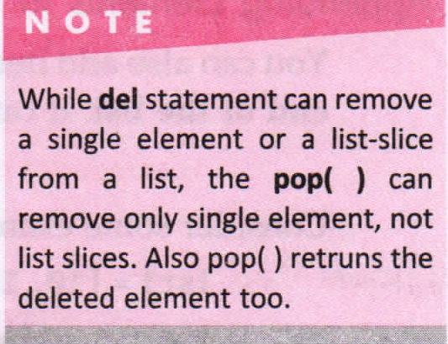

Slide 25
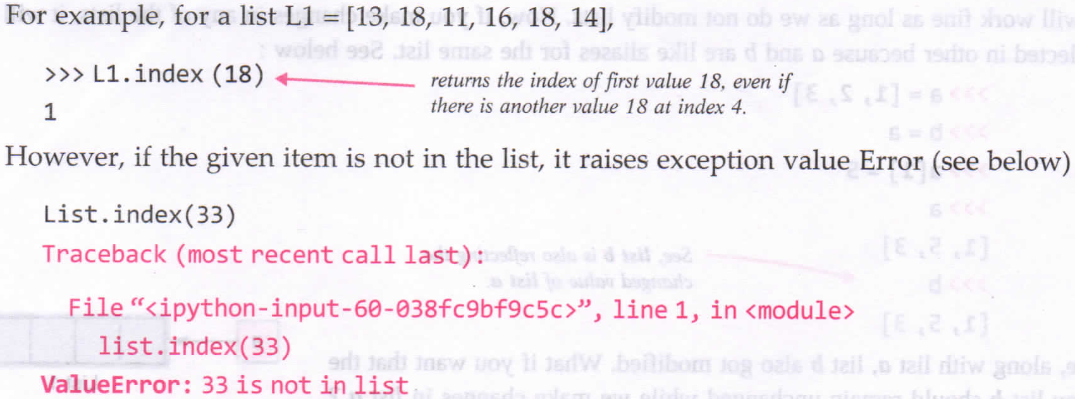
index() method
The function return the index of first matched item from the list.
FORMAT: List.index(<item>)

Slide 26
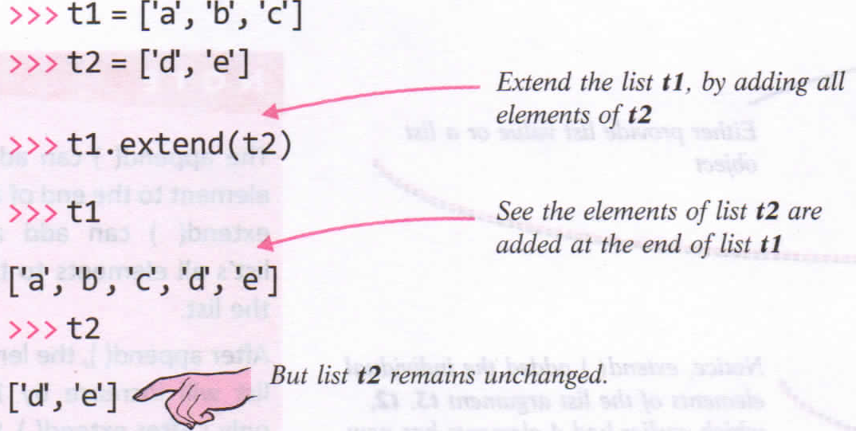
extend() method
Also used for adding multiple elements given i the form of a list to a list.
FORMAT: List.extend(<list>)

Slide 27
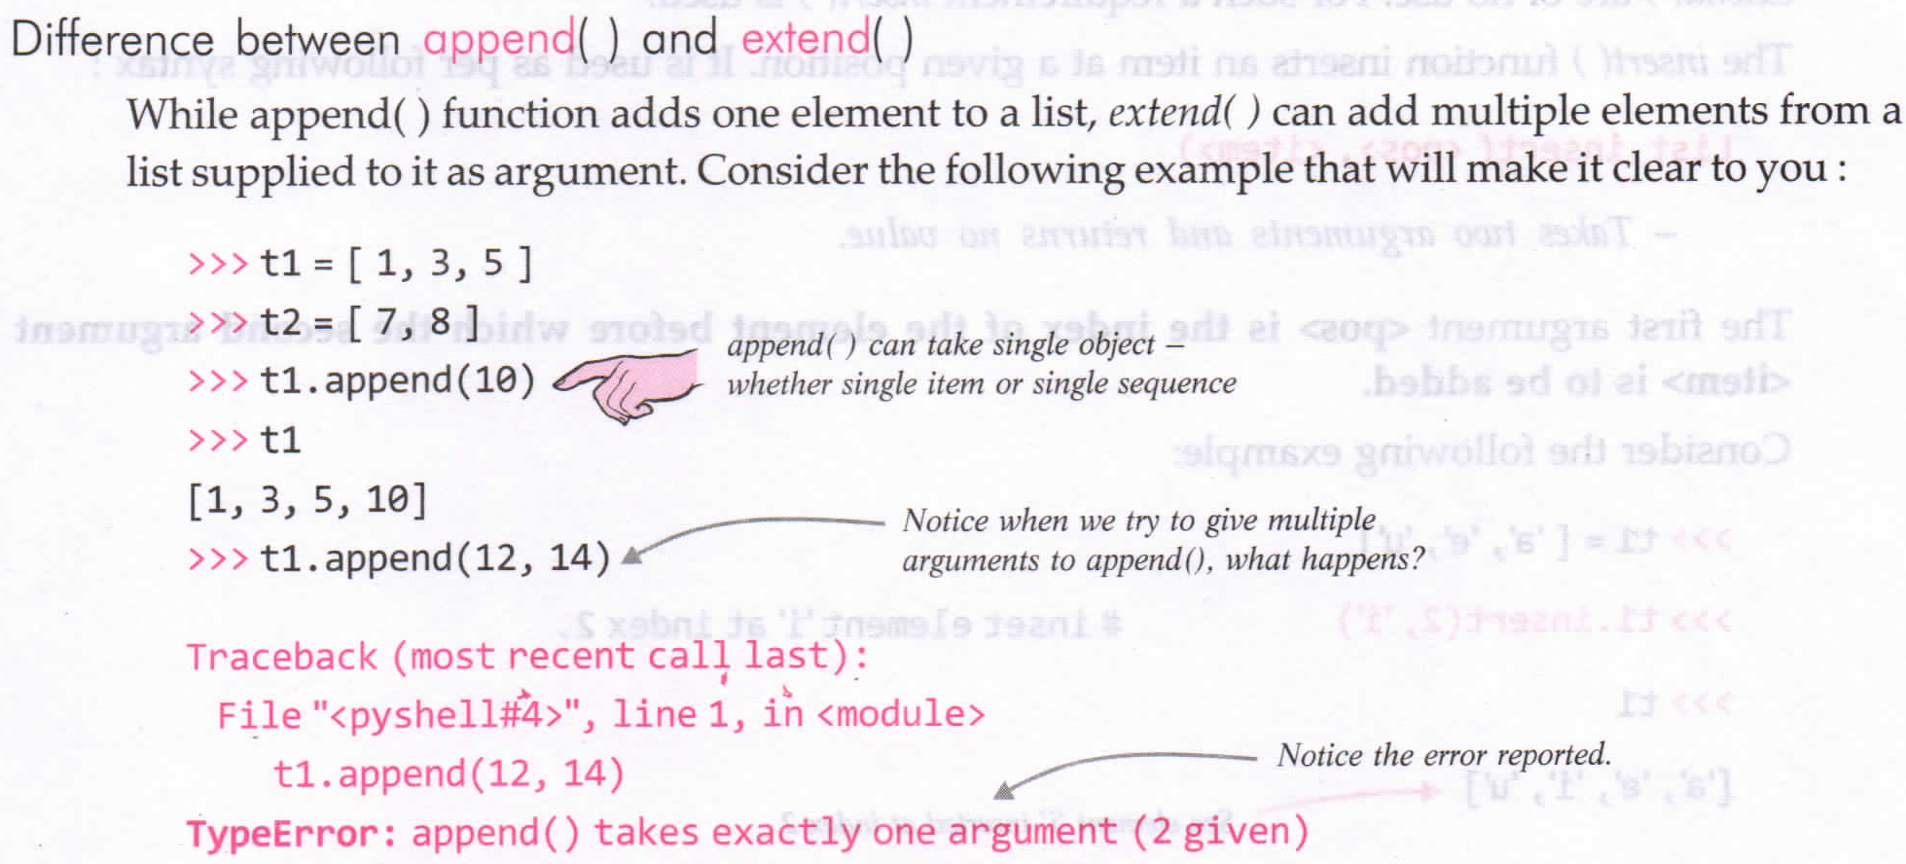

Slide 28
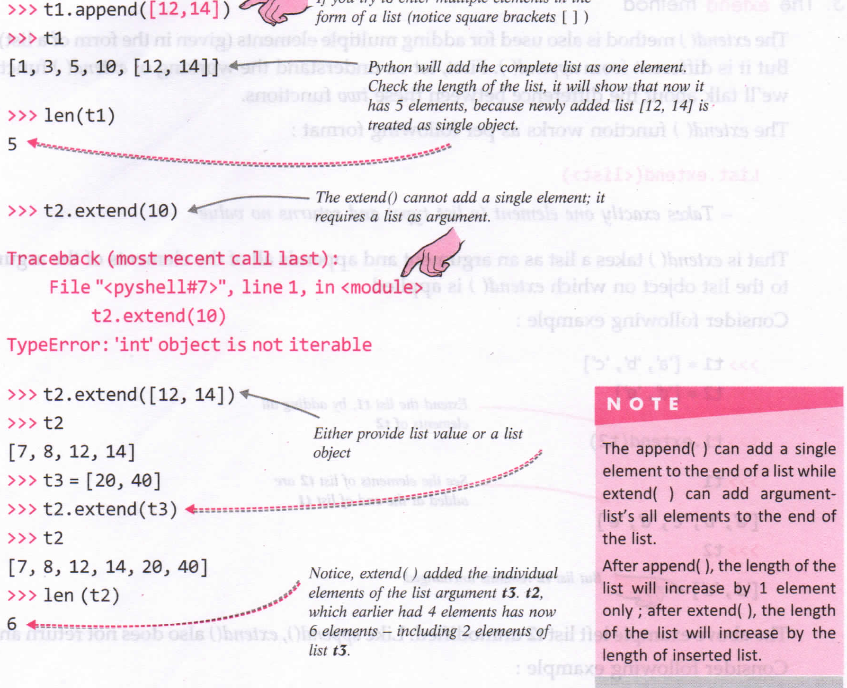

Slide 29
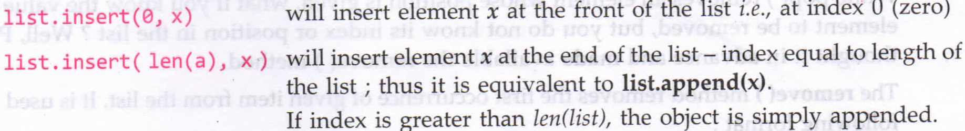
insert() function
insert() method is also insertion method for lists, like append() and. extend().
insert() function inserts an tem at a given position.
FORMAT: List.insert(<position>,<item>)
,pos = index of the element before which second argument <item> is to be added.
T1 = [‘a’, ‘e’, ‘u’]
T1.insert(2,’i’) Output: [‘a’, ‘e’, ‘i’, ‘u’]

Slide 30
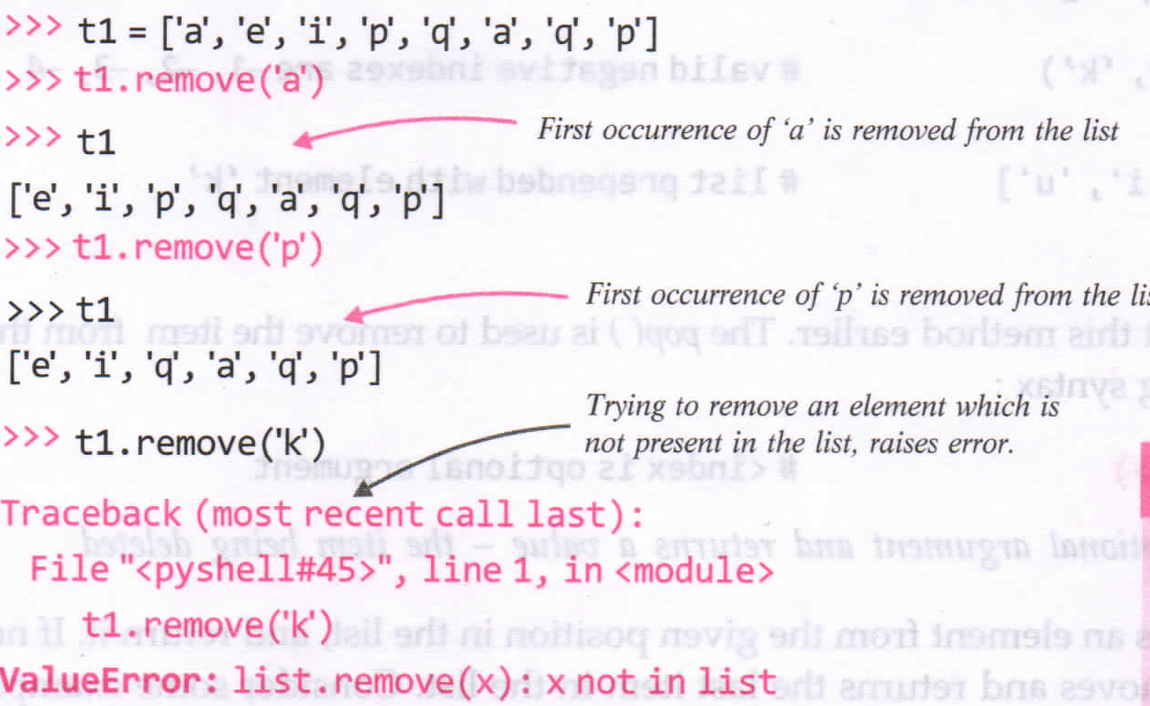
remove() function
pop() removes an element whose position is given.
remove() method removes the first occurrences of given item from list. FORMAT: List.remove(<item>)

Slide 31
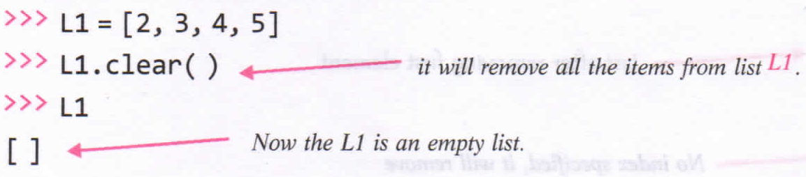
clear() method
Method removes all the items from the list and the list becomes empty list after this function.
FORMAT: List.clear()

Slide 32
count() method
Function returns the count of the item that you passed a argument.
If the given item is not in the list it return zero.
FORMAT: List.count(<item>)
L1 = [13,18,20,10,18,23]
L1.count(18) #Output: 2
L1.count(13) #Output: 1
L1.count(11) #Output: 0

Slide 33
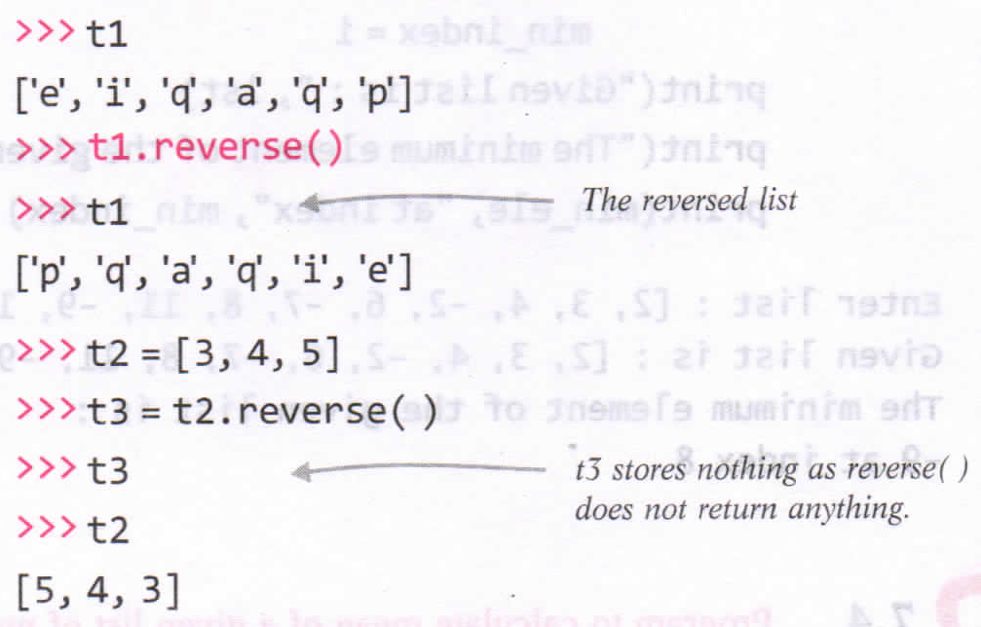
reverse() method
reverse() d=function reverses the items of the list.
FORMAT: List.reverse()

Slide 34
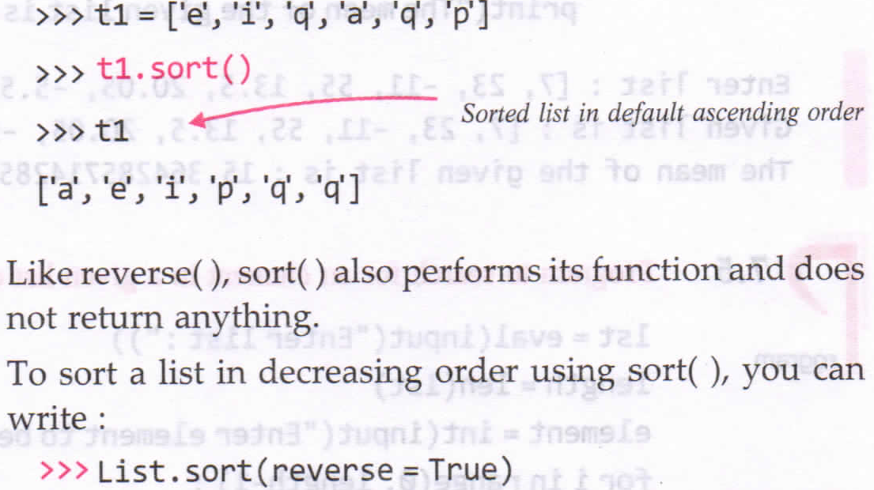
sort() method
sort() function sorts the items of the list, by default i increasing order.
FORMAT: List.sort()

Slide 35
Programs
P1: Program to find the minimum and maximum element from a list of elements along with its index in the lists.
P2: Calculate the mean of a given list numbers.
P3: Program to search for an element in a given list of numbers.(Linear Search)
P4: Program to count frequency of a given element in a list of elements.

